Slide 1
NPTEL
Video Course on Machine Learning
Professor Carl Gustaf Jansson, KTH
Week 6 Machine Learning based
on Artificial Neural Networks
Video 6.7 Hopfield Networks and Boltzman Machines – Part 1

Slide 2
Structure of Lectures in week 6
L1 Fundamentals of
Neural Networks
McCulloch and Pitts
Supervised learning L3 Perceptrons Linear L2 Hebbian Learning and
- classification classification Associative Memory
- regression
L4 och L5 Feed forward multiple layer Reinforcement
networks and Backpropagation learning Unsupervised learning
L6 Recurrent Neural Sequence and L7 Hopfield Networks and
Perception Networks (RNN) temporal data Boltzman Machines
L8 Convolutional Neural
Networks (CNN)
L9 Deep Learning and We are here now
recent developments
L10 Tutorial on assignments
Development of
the ANN field

Slide 3
Hopfield Networks
A Hopfield network :
is one approach to the realization of associative memory
is an instance of an auto-association memory
is considered a recurrent neural network (RNN), even if it is not able to handle temporal sequences,
but it has states and cycles in the network
is a one layer neural network in the sense that all units are input/output units
is a fully-connected neural network with symmetric weights.
has units modelled as inspired by the Mcculloch and Pitts neuron model.
can have its states updated in a syncronous as well as an asyncronous mode
has weight updating mechanisms based upon Hebbian learning
has an Energy concept that ensures a convergence towards a stationary state.
the model enables fix point stable attractors.
Hopfield networks were invented by John Hopfield in 1982.

Slide 4
Updating Units in a Hopfield Network
´One shot learning´ : Assuming that X is a matrix with N dataitem vectors as rows
The weight matrix W = 1/N * (X^{T} X)
Updating the state of one unit in the Hopfield network is performed using the following rule:
Si = +1 if Sum j Wij * Sj >= threshold for unit i otherwise -1
where:
Wij is the strength of the connection weight from unit j to unit i.
Sj is the state of unit j
Thus, the values of neurons i and j will converge if the weight between them is positive. Similarly, they will diverge if the weight is negative.
Updates in the Hopfield network can be performed in two different ways:
Asynchronous: Only one unit is updated at a time. This unit can be picked at random, or a pre-defined order can be imposed
Synchronous: All units are updated at the same time. This requires a central clock to the system in order to maintain synchronization. This method is viewed by some as less realistic, based on an absence of observed global clock influencing analogous biological or physical systems of interest.

Slide 5
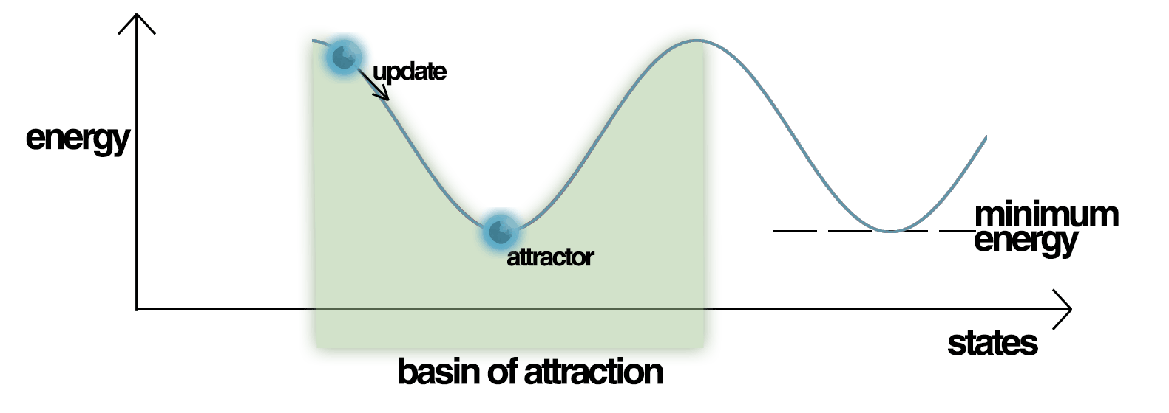
Energy
Hopfield nets have a scalar value associated with each state of the network, referred to as
the Energy E of the network, where:
E=-1/2 * Sum Sum Wij * Si * Sj + Sum Treshold i* Si.
i j i
This scalar value is called the energy because the definition ensures that, when units are randomly chosen to update, the value of the energy, E, will either decrease or stay the same.
Repeated updating of the network will eventually converge to a state which is a local minimum in the energy function. If a state is a local minimum for the energy function it is a stable state for the network.

Slide 6
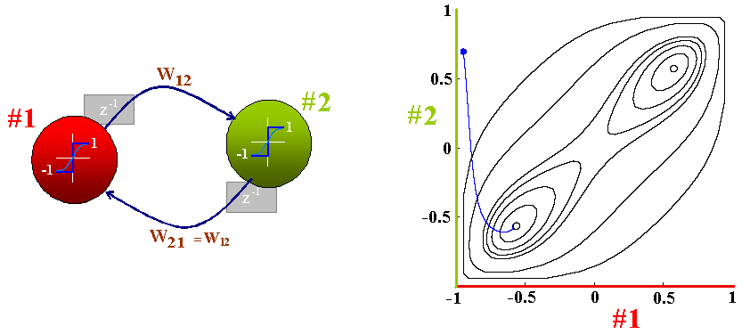
A 2-neurons Hopfield network
characterized by 2 stable states
1st Example

Slide 7
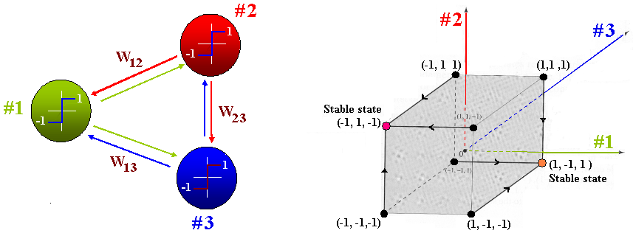
A 3-neurons Hopfield network of 2³=8 states characterized by 2 stable states
2nd Example

Slide 8
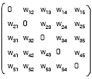
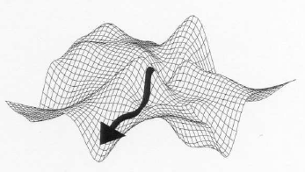
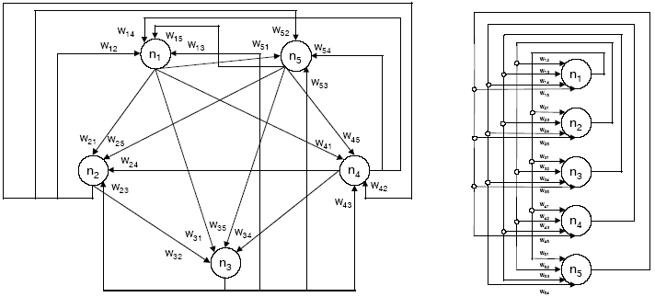
A 5-neurons Hopfield network with its weight matrix
3rd Example
W_{ij} = W_{ji}
Can be thought of as an Energy minimization process

Slide 9
Hopfield Network Example (1)
1. Patterns to Remember
3. Build Network
p₁
p₂
p₃
1/3
1
2
1
2
1
2
1
2
1/3
[-]
3
4
3
4
3
4
-1/3
-1/3
[+]
1/3
3
4
2. Hebbian Weight Init:
Avg. Correlations across 3 patterns
-1
p₁
p₂
p₃
Avg
4. Enter Test Pattern
W₁₂ 1 1 -1 1/3
1/3
W₁₃ 1 -1 -1 -1/3
1
2
1/3
W₁₄ -1 1 1 1/3
-1/3
-1/3
3
4
1/3
W₂₃ 1 -1 1 1/3
W₂₄ -1 1 -1 -1/3
-1
+1
0
-1
W₃₄ -1 -1 -1 -1
Threshold = 0

Slide 10
Hopfield Network Example (2)
Synchronous Iteration (update all nodes at once)
W = 1 1/3 -1/3 1/3
1/3 1 1/3 -1/3
-1/3 1/3 1 -1
1/3 -1/3 -1 1
Test case S = 1 0 0 -1
Si = +1 if Sum j Wij * Sj >= 0 otherwise -1
Si new = 1 1 1 - 1
1/3
p₁
1/3
=
-1/3
1
2
-1/3
1/3
3
4
-1
Stable State

Slide 11
Hopfield Network Example (3) Matrix calculation
matrix X = V1
V2 1. W = X^{T}X / N
VN where N = # of
patterns (input vectors) 2. testing with training pattern 3. apply a treshold = 0
Example
1 1 -1 3 1 -1 1 1 1/3 -1/3 1/3
1 1 1 1 1 1 -1 1 3 1 -1 1/3 1 1/3 -1/3
X^{T}= 1 -1 1 X = 1 1 -1 1 1.a X^{T}X = -1 1 3 -3 1b. -1/3 1/3 1 -1
-1 1 -1 -1 1 1 -1 1 -1 -3 3 1/3 -1/3 -1 1
Test 1 1 1/3 -1/3 1/3 - > 2/3 2/3 2/3 -2/3 -> S = 1 1 1 -1
0 1/3 1 1/3 -1/3 same result
0 -1/3 1/3 1 -1
-1 1/3 -1/3 -1 1

Slide 12
Hopfield Network Example (4)
Asynchronous Iteration (units are chosen randomly)
1/3
1
2
1/3
-1/3
-1/3
3
4
1/3
-1
1/3
1/3
1/3
Stable
Pattern
p₃
1/3
1/3
1/3
-1/3
-1/3
-1/3
-1/3
-1/3
-1/3
1/3
1/3
1/3
-1
-1
-1

Slide 13
To be continued

